Slide 1
Bank of Baroda Hackathon 2024
Your Team Name : GeakMinds Team 1
Your team bio : Siddharth, Mishab, Joel, Robin
Date : 28-06-2024

Slide 2
Problem Statement ?
Form filling and verification takes a lot of processing time and needs simplification and automation.
Loan documents processing and approval is a time-consuming process.
Manual processing of the Unstructured data needs to be eliminated.
Chances of error in repetitive tasks is high and can be costly.

Slide 3
Pre-Requisite
The other IDP services are on the developmental stage
Solution build on other Platforms(not build on Azure).

Slide 4
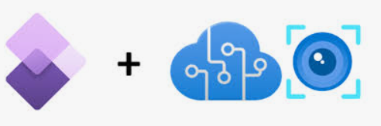
Tools or resources
Azure OpenAI service (for LLM and AI)
Power Apps/Power Automate (Process automation)
Azure AI Document Intelligence,
Azure Functions
Azure Vision
Azure Cognitive Service for Language,
Azure Machine Learning
Delta Lake Storage

Slide 5
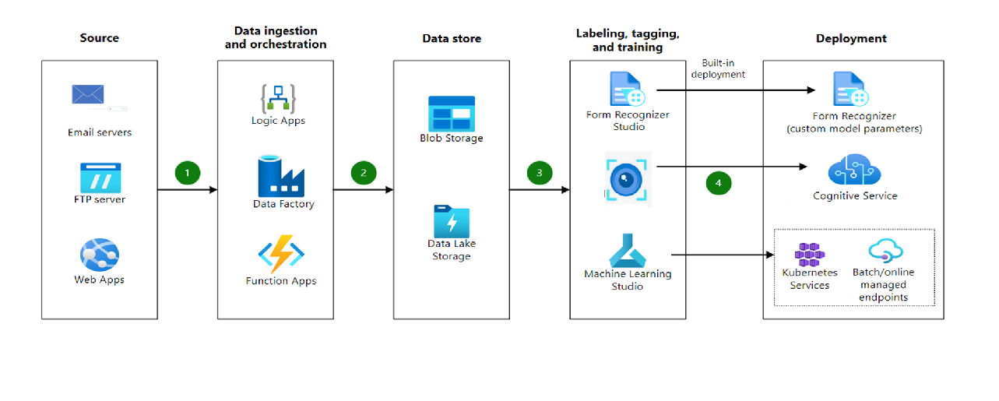


Any Supporting Functional Documents
Architecture for Development of the Intelligent Document Processing.
User Interface
Open AI

Slide 6
Key Differentiators & Adoption Plan
Easy to build and Scale
Fully managed Services with low maintenance.
Integrated Solution based on multiple types of data.
ADOPTION PLAN
The application can be integrated with the existing communication platform like Teams so that the people don’t find difficulty in using the platform.

Slide 7
GitHub Repository Link & supporting diagrams, screenshots, if any
GitHub Link - https://github.com/rjrobin18

Slide 8
Business Potential and Relevance
Application of Intelligent Documents Processing and Process automation in Banking Sector
Decrease the Operation time by automating certain processes (filling of forms, checking of documents, etc.)
Combines OCR, AI, machine learning, and NLP to capture, extract, and process data from various document types.
Works on Structured as well as the Non-Structured Data.
Fast and efficient for repetitive tasks.
Automation of the traditional systems.

Slide 9
Uniqueness of Approach and Solution
The proposed solution combines information from the digital documents, scanned documents and images which helps bank employees have the complete information and intelligence from the information at their fingertips.

Slide 10
User Experience
This helps the bank employees to have all the information required to complete their job at one place.
Today they need to switch between multiple applications and enquire with various people to complete their job.

Slide 11
Scalability
Deploying this in Microsoft Azure ensures scaling this to thousands of employees and millions of documents easily.

Slide 12
Ease of Deployment and Maintenance
This being a low code solution and using fully managed Azure services it would be easy to maintain.

Slide 13
Security Considerations
Azure has its own security compliance, this solution will completely rely on Azure for the security compliance, however this application will be deployed with private endpoints.

Slide 14
Thank You
Mishab, Siddharth, Joel, Robin

